Slide 1
Vision Ministries Kenya Style, Church Planting, (all in one week) 肯尼亚风格的Vision事工
One on one witnessing 一对一做见证
Door to door / home to home witnessing 门对门,家到家的见证
Revival crusade 复兴争战
Christian film show 放映基督教电影
VMK Leadership training for the church leaders 教会领袖培训
Building of the church (the actual building) 建立教堂(实际建筑)
Breaking of the bread 掰饼

Slide 2
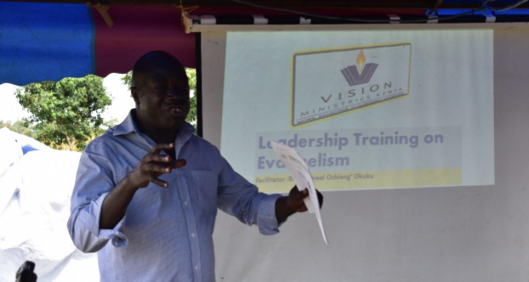

Slide 3
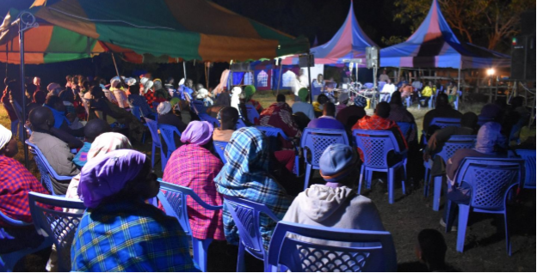

Slide 4
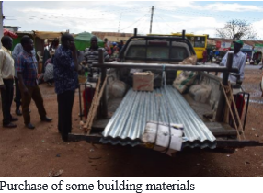
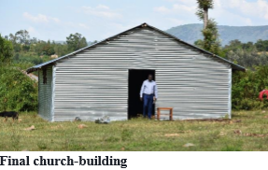
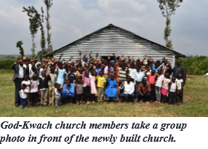
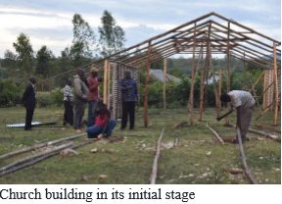

Slide 5
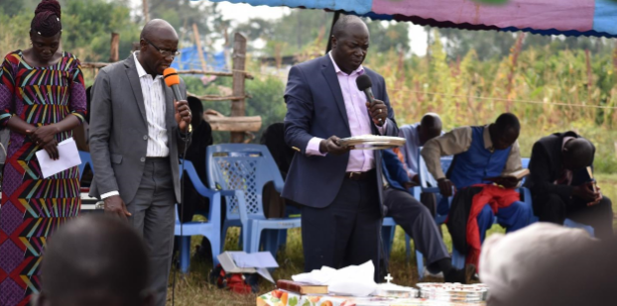

Slide 6
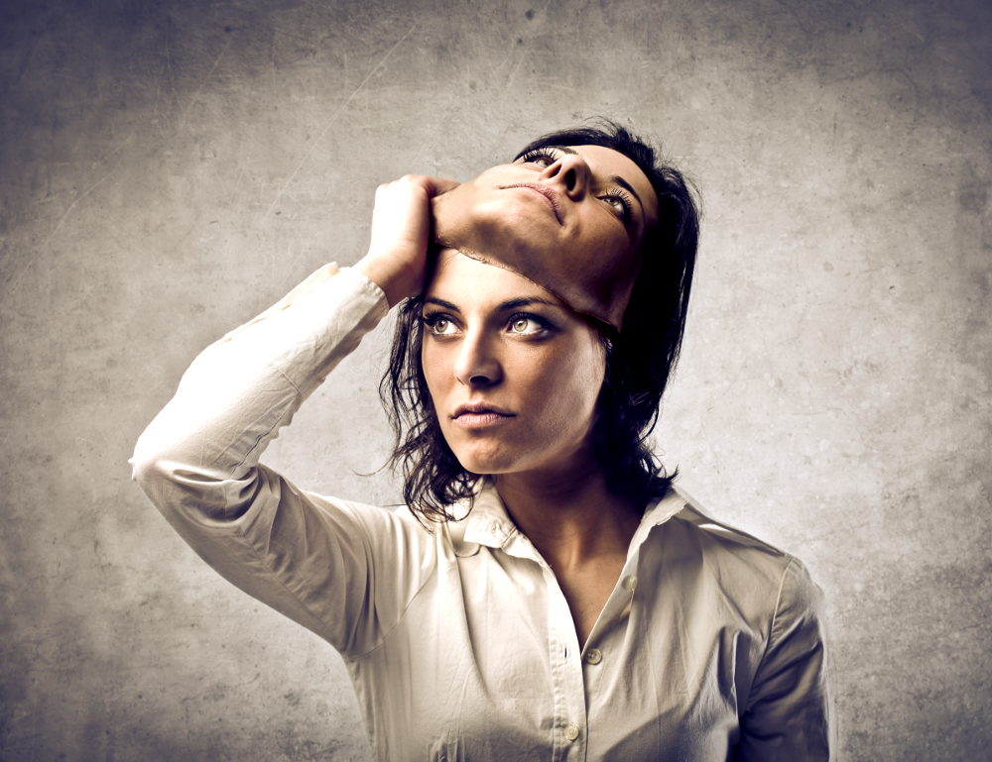
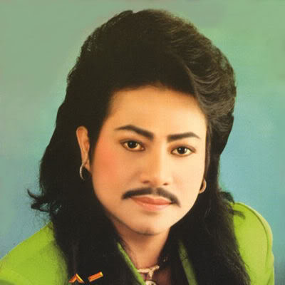
Who are these people?

Slide 7
The Bible says to believers, You are a Priest 圣经告诉信徒, 你就是祭司
And much, much more! 还有许多
Don’t allow your self to think, you are a “nobody”
不要认为你一无是处
or that you have to “invent” yourself
或者你要从新”发明”自己

Slide 8
What do you think of when you hear the word, priest?
听到祭司这个词, 你是怎么想的?

Slide 9
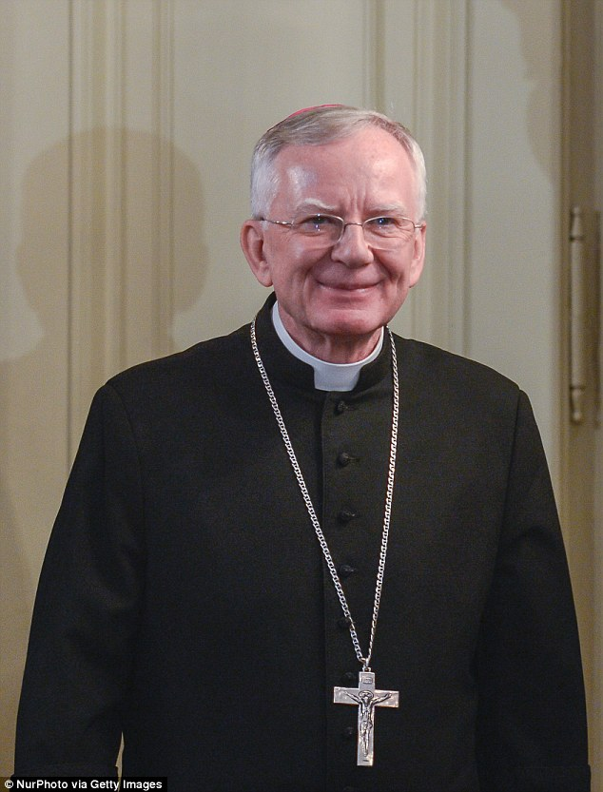
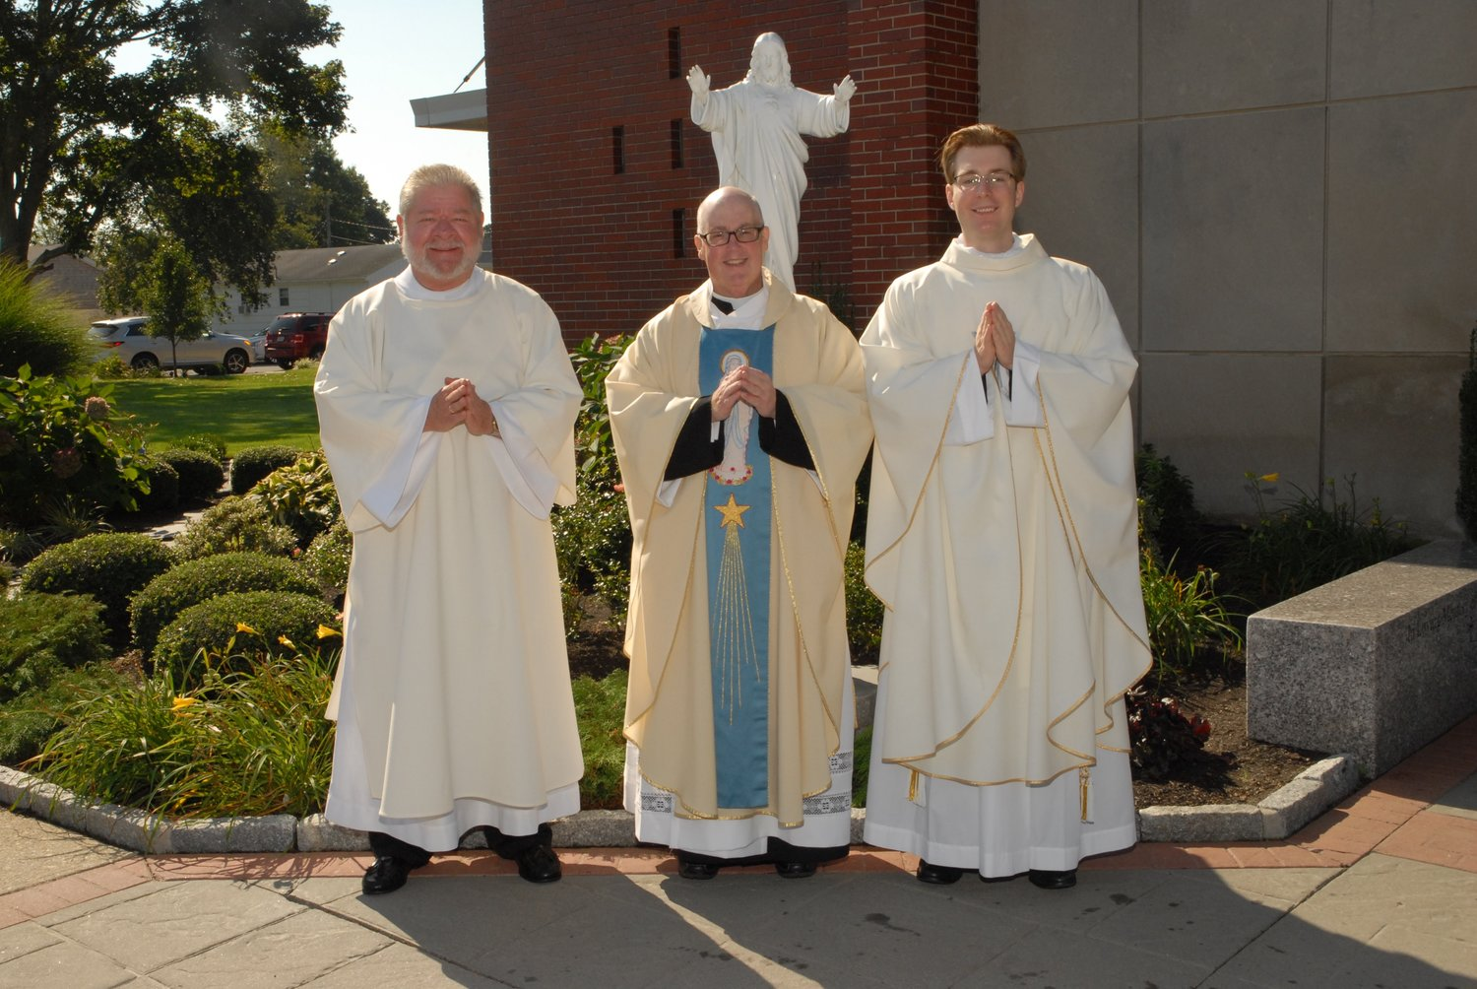
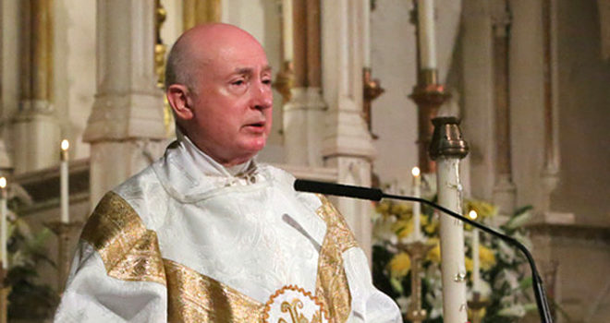

Slide 10
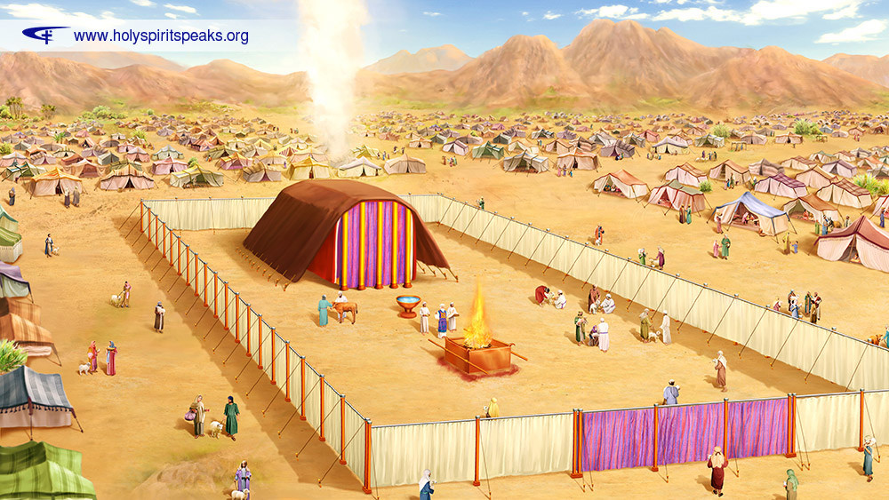

Slide 11
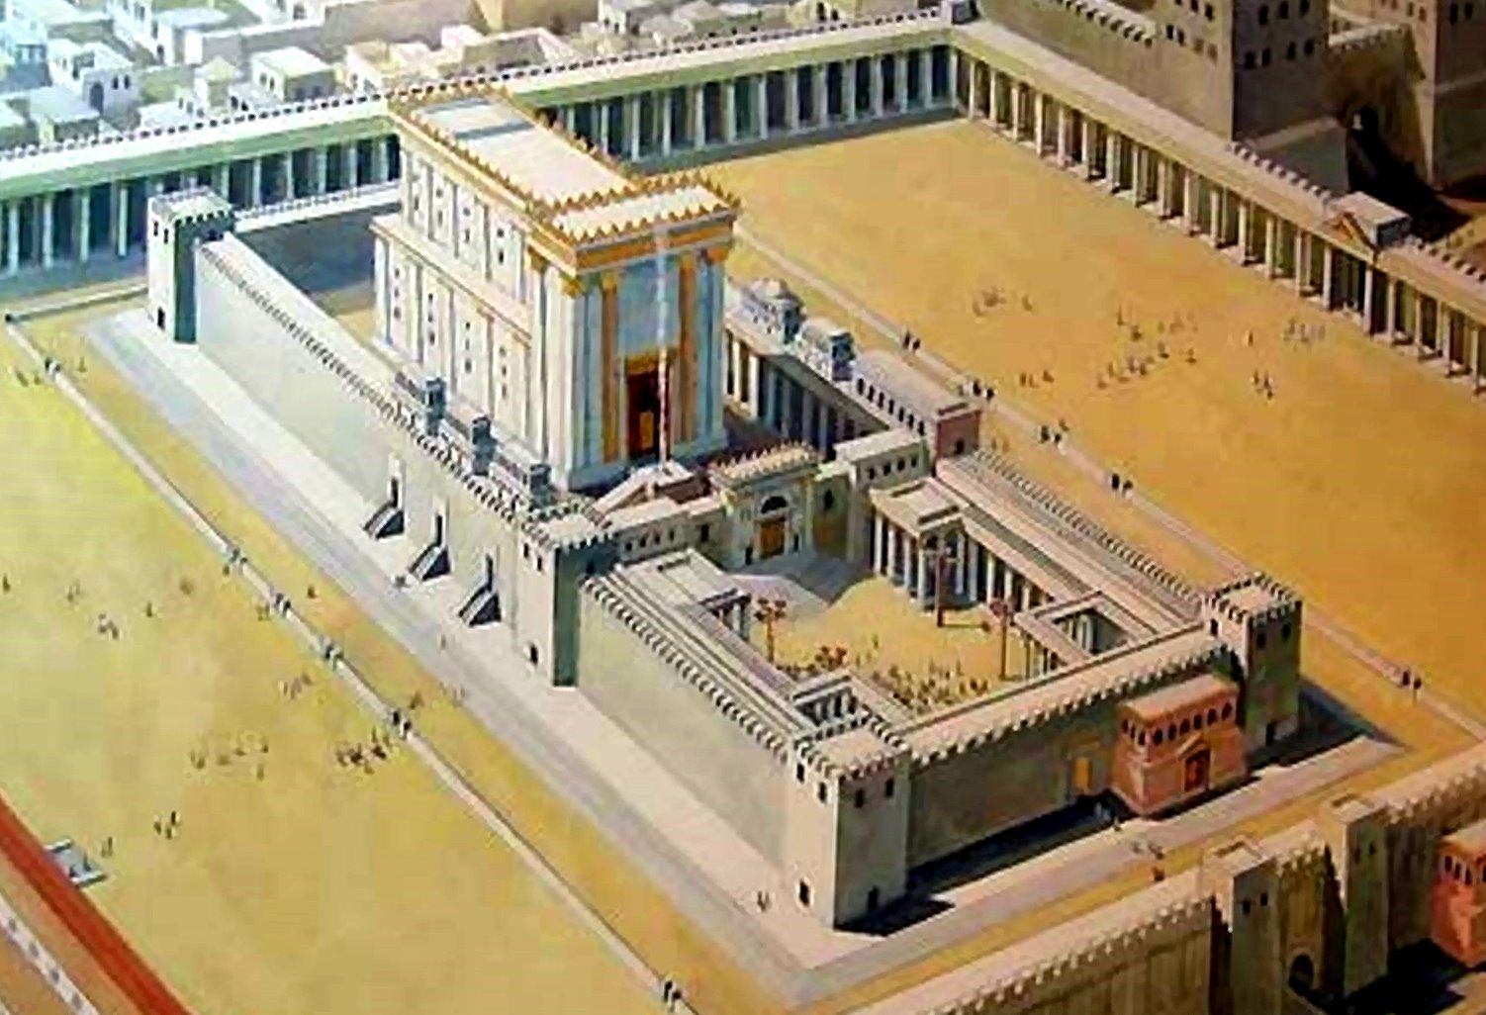

Slide 12
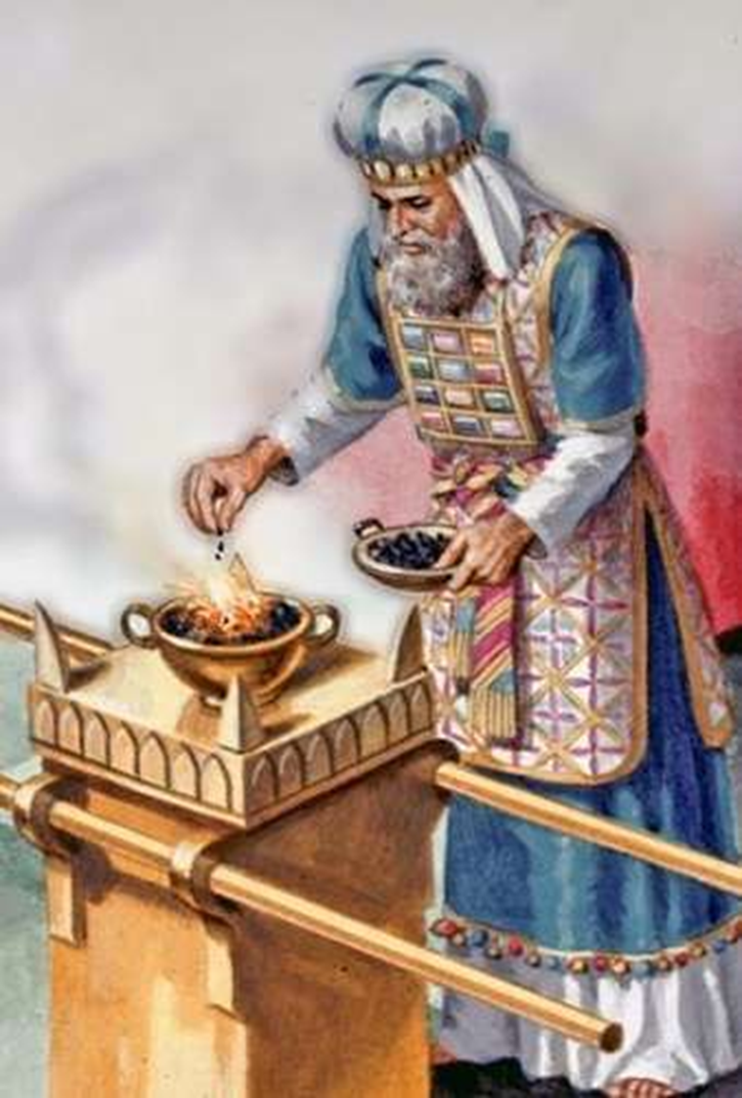

Slide 13
The Bible says to believers, You are a Priest 圣经告诉信徒, 你们就是祭司
And much, much more! 还有许多
Don’t allow your self to think, you are a “nobody”
不要认为你一无是处
or that you have to “invent” yourself
或者你要从新”发明”自己

Slide 14
The Bible says you 圣经说, 你是 … I Peter Chapter 1:1-2:2 彼得前书 1:1-2:2
Are Chosen 被拣选
Are Sanctified 被洁净
Are Sprinkled 血所洒的
Have New Birth 重新生的
Have a Living hope 活泼的盼望
Have an Inheritance 永恒基业
Are Shielded 蒙保守的
Have Salvation 有救恩
Are Redeemed 被救赎
Be self-controlled 节制
Set your hope…on grace 盼望来自恩典
Be holy 成为圣洁
Live your life in reverence 活出尊严
Abstain from sinful desires 离开罪的欲望
Live good lives 活出好的生命
Crave the milk of the word 渴望灵奶
Love each other deeply 彼此深深相爱
Get rid of malice, deceit, hypocrisy, envy, slander 除掉恶毒, 诡诈, 伪善, 嫉妒和毁谤

Slide 15
You, are part of a growing spiritual building, the global church, in which you serve as priests 你是不断建造的灵宫的一部分, 这灵宫就是教会, 你们如同祭司一样在其中事奉
I Peter 2:4 As you come to him, the living Stone—rejected by men but chosen by God and precious to him— 主乃活石, 固然是被人所弃的, 却是被神所拣选所宝贵的. 你们来到主面前
This “Stone” Predicted by a Isaiah 28:16, 700 years before 以赛亚书 28:16 在700多年前就预言了这块石头
As you come to Christ, you are coming to this Stone 你来到基督这里, 就是来到这块石头这里
You may be rejected by the world, just like Jesus 你可能被世界弃绝, 正像基督被弃绝一样
But you are “chosen and precious “ to him 但是你是被拣选的,是珍贵的

Slide 16
5 you also, like living stones, are being built into a spiritual house to be a holy priesthood, offering spiritual sacrifices acceptable to God through Jesus Christ. 你们也像活石, 被建造成为灵宫,作圣洁的祭司,藉着耶稣基督奉献神所悦纳的灵祭
You are being built on “that stone” into a spiritual house 你们被建造在那块石头上, 要建成灵宫
Which is the global church that Jesus is building 这就是耶稣要建立的普世教会
In this house or the global church 在这灵宫或称普世教会中
You are the holy priests 你们是圣洁的祭司
Offering spiritual sacrifices 献上灵祭
Hebrews 13:15 Therefore, let us offer through Jesus a continual sacrifice of praise to God, proclaiming our allegiance to his name. 希伯来书13:15 所以, 我们应当靠着耶稣,常常以颂赞为祭献给神, 这就是那承认主名之人嘴唇的果子 (宣告我们对神的忠心)

Slide 17
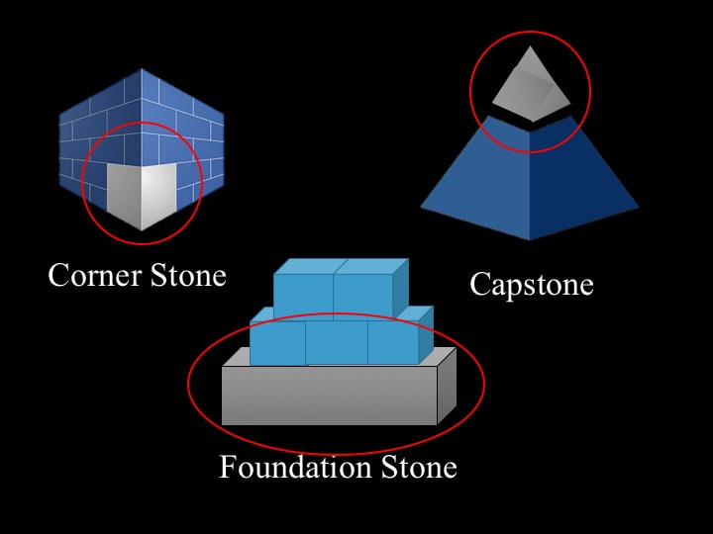
6 For in Scripture it says: “See, I lay a stone in Zion, a chosen and precious cornerstone, and the one who trusts in him will never be put to shame.” 因为经上说, “看哪, 我把所拣选所宝贵的房角石安放在锡安, 信靠他的人必不至于羞愧”

Slide 18
I Peter 2:7 Now to you who believe, this stone is precious.
所 以 他 在 你 们 信 的 人 就 为 宝 贵
Believers? Find him precious! 信徒? 看耶稣为宝贵
But to those who do not believe, “The stone the builders rejected has become the capstone,” 8 and, “A stone that causes men to stumble and a rock that makes them fall.” 在那不信的人有话说，匠人所弃的石头，已作了房角的头块石头。又说，作了绊脚的石头，跌人的磐石。
Those who do not believe, they reject him 不信的人,弃绝他
Will be humiliated because the one they reject becomes the corner stone! 这些不信的人要羞愧,因为他们弃绝了成为房角石的耶稣
They stumble because they disobey the message—which is also what they were destined for. 他们跌倒,是因为他们拒绝福音,这也是他们注定的结局
Their disobedience fits their destiny 他们的不顺服与他们的结局相称

Slide 19
I Peter 2:9 But you are 彼得前书２:９但你们是
a chosen people, 被拣选的族类
a royal priesthood,君尊的祭司(Exodus 19:6 “kingdom of priests” 祭司的国度)
a holy nation, 圣洁的国度
a people belonging to God, 属神的子民
that you may declare the praises of him who called you out of darkness into his wonderful light. 要叫你们宣扬那召你们出黑暗入奇妙光明者的美德
10 Once you were not a people, but now you are the people of God; once you had not received mercy, but now you have received mercy. 你 们 从 前 算 不 得 子 民 ， 现 在 却 作 了 神 的 子 民 。 从 前 未 曾 蒙 怜 恤 ， 现 在 却 蒙 了 怜 恤

Slide 20
“Christian selfhood is not defined in terms of who we are in and of ourselves. It’s defined in terms of what God does to us and the relationship he creates with us and the destiny he appoints for us.
God made us who we are so we could make known who he is.
Our identity is for the sake of making known his identity.”
“基督徒的自我不是由我们自己的状况来定义的, 而是取决于神为我们所做的,以及他所建立的和我们之间的关系, 还有他为我们指派的归宿. 神创造了我们现在的样子, 所以我们可以让世人知道他是谁,他又是怎样的. 我们的身份就是让他的身份被彰显出来”

